Slide 1
Bank Term Deposit Analysis and Prediction

Slide 2
Introduction
Bank Term Deposit Analysis and Prediction

Slide 3
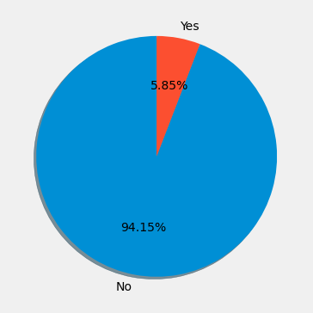
Analysis of dataset

Slide 4
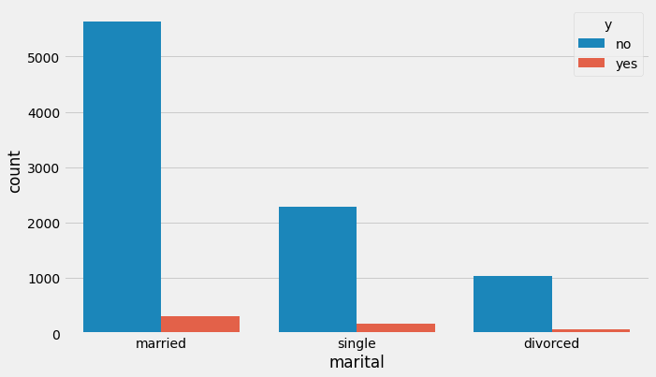
PEOPLE BY Subscription AND MARTIAL STATUS

Slide 5
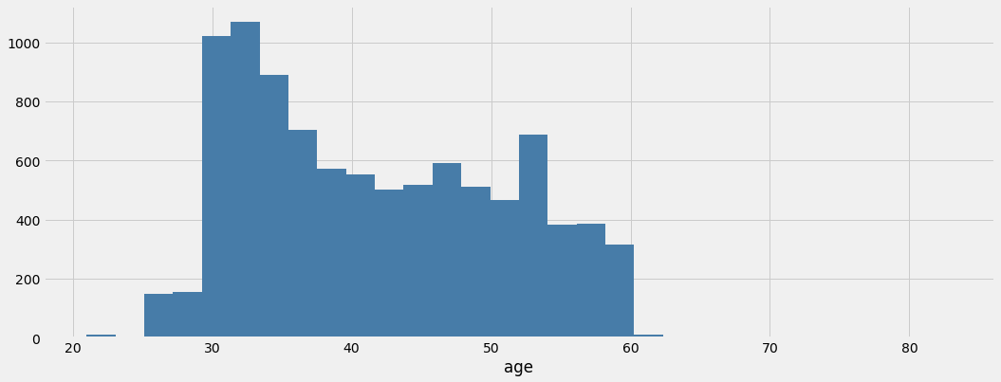
Customers age distribution

Slide 6

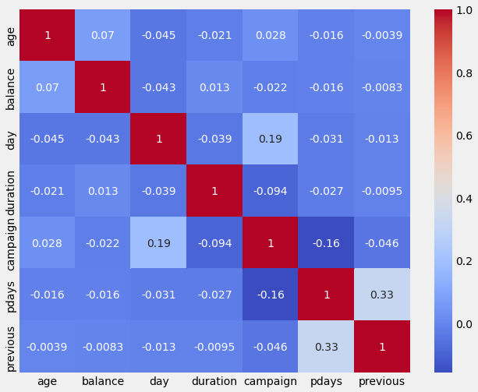
Numeric Features relationship analysis

Slide 7
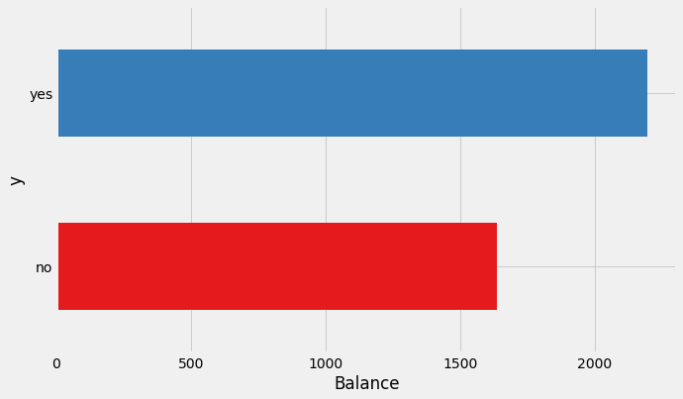
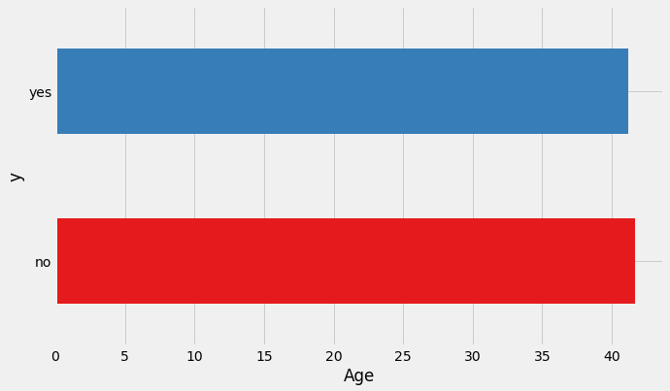
Age and balance effect on subscription

Slide 8
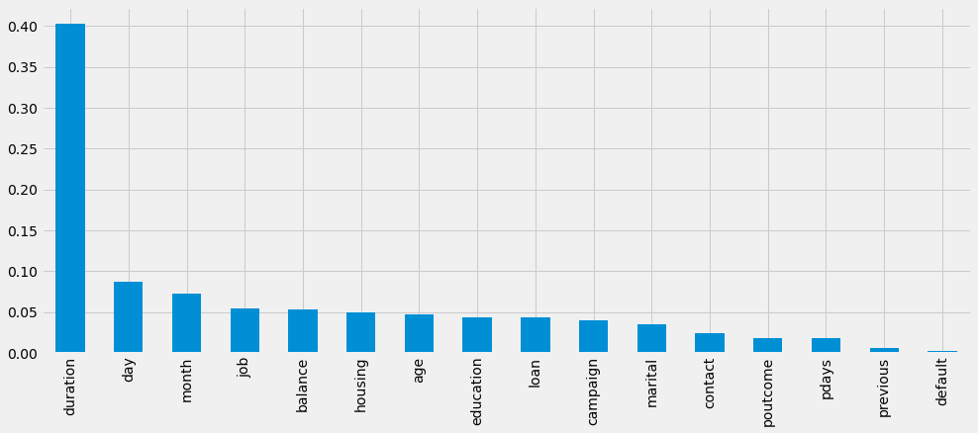
Feature importance

Slide 9
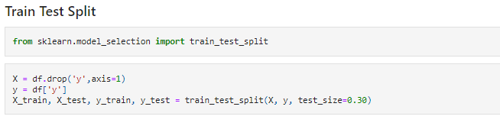
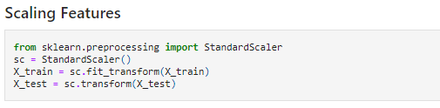
Train test split and feature scaling

Slide 10
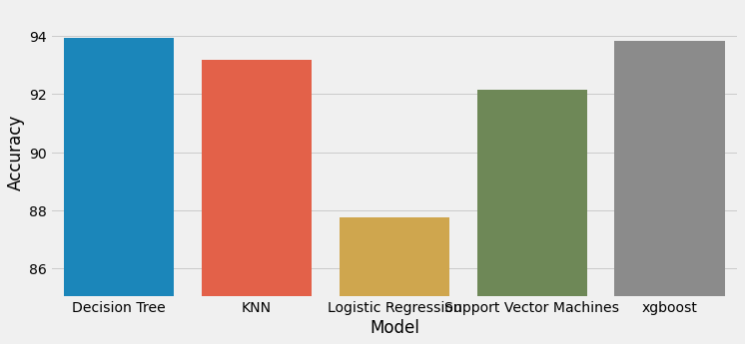
Models Accuracy

Slide 11
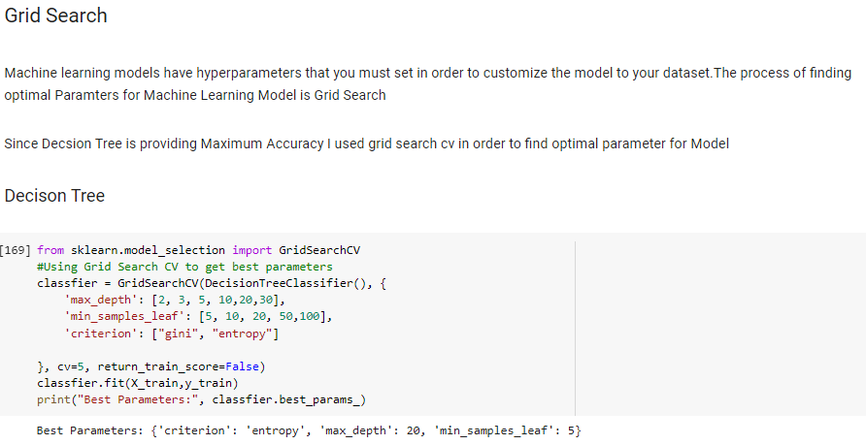
Hyper parameter tuning

Slide 12
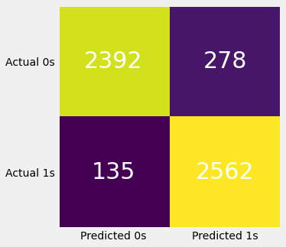
CONFUSION MATRIX

Slide 13
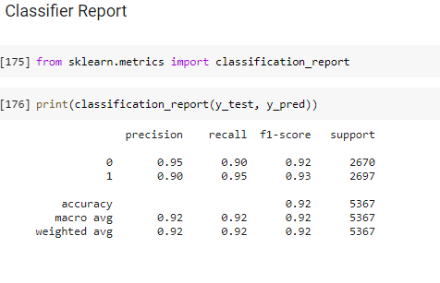
Classification Report

Slide 14
Thankyou! Everyone

